Slide 1
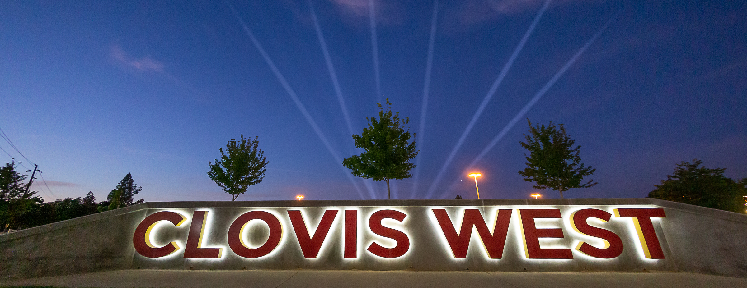
CLASS OF 2025 Registration
Clovis West High School

Slide 2
Registration Dates Tammy Brisky
Registration: February 22-27th
All current 8th grade students will register online via Student Connect through their AB class.
You can access the Clovis West Registration Website for updated information.

Slide 3
Required 9th Grade Classes Tammy Brisky
All Freshmen must take:
English
Math
Physical Education (PE)
Health
*To be NCAA compliant, recommend four academic classes per year.
Students must pass all classes with a D or higher.

Slide 4
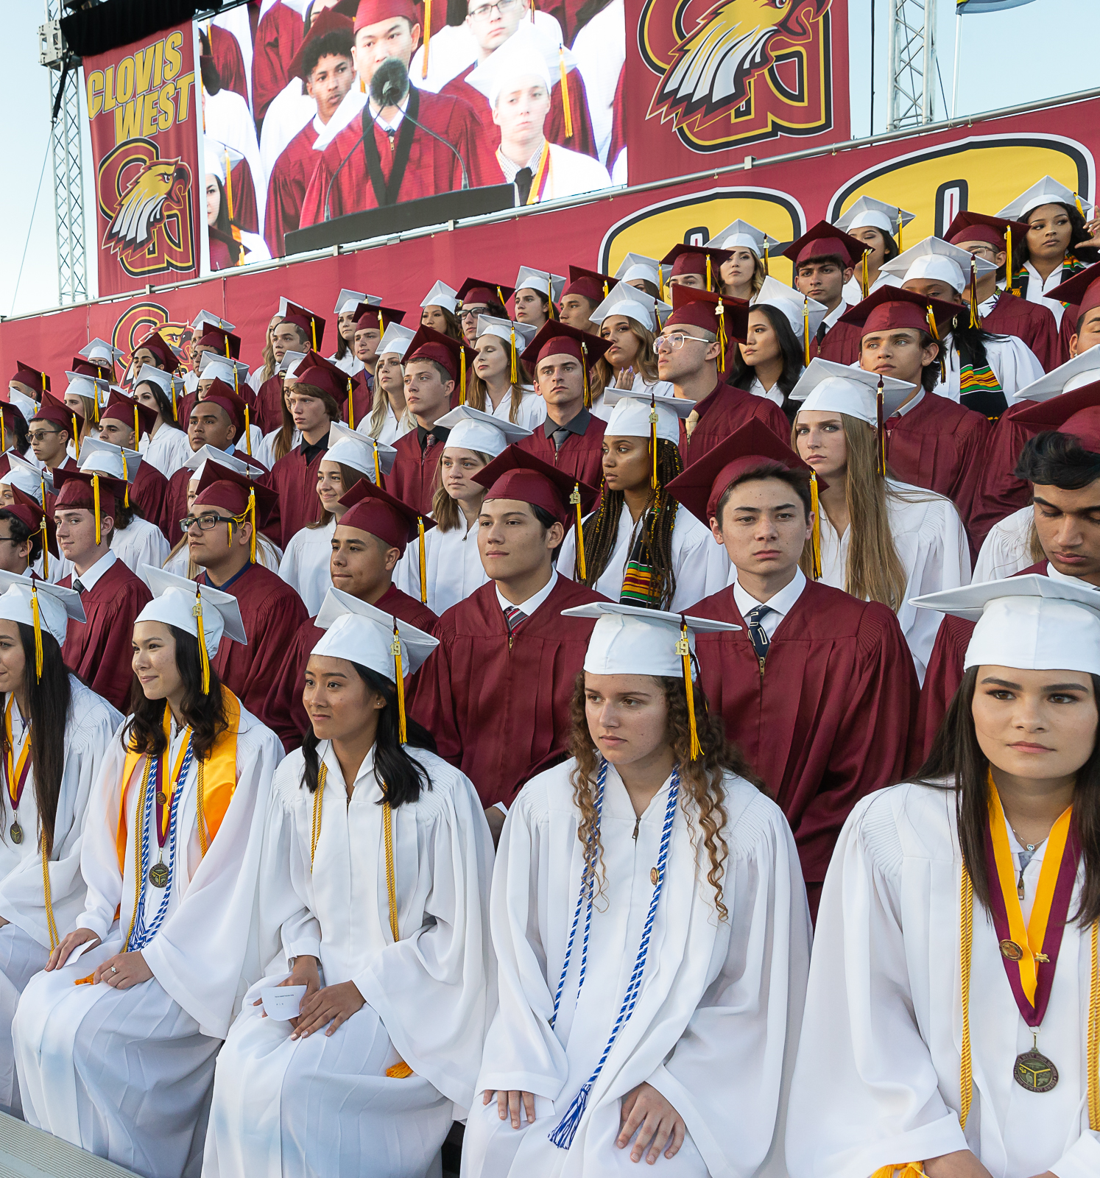
Clovis West Graduation Requirements Josie Vargas
Credits: 230
English: 4 years
Math: 2 years
Including Math 1 & Math 2
Science: 2 years
Including Physical (1) & Life (1)
Social Science: 3 years
PE: 4 years
Health: 1 semester

Slide 5
English Josie Vargas
English 9
Fulfills high school and CSU/UC requirement.
English 9 Honors
Fulfills high school and CSU/UC requirement.
A in AB Language Arts.
Overall GPA of 3.5 or higher.
AB teacher approval.
Complete questionnaire provided in your AB teacher’s google classroom.
Must complete assigned summer work

Slide 6
Math Anthony Bringetto
Math 1
Math 2
Honors Math 2
Current Math grades will determine Math level placement for next year.

Slide 7
Math Placement Guidelines Anthony Bringetto
8th Grade Math at Kastner | 1st and 2nd Semester Grade | 9th Grade Placement
Math 8 |  | Math 1
Advanced Math 8 | A or B AND Must take Placement Test | Math 2 or Honors Math 2
 | C,D, or F | Math 1

Slide 8
Science Andrea Yang
Integrated Physical Science 1
Biology
Honors Biology
Chemistry

Slide 9
Science Pathway Andrea Yang
9th Grade Math Placement | 9th Grade Science Course
Math 1 | Integrated Physical Science (or) Biology if student has earned “C”s both semesters of Science 8.
Math 2 and/or English 9 Honors | Honors Biology
Math 2 Honors | Chemistry

Slide 10
World Language Andrea Yang
2.5 GPA needed to enroll in a World Language.
Spanish 1 and 2
Chinese 1
French 1
Honors Spanish 2 – offered for students who are native speakers.
2 years of the same World Language is required by the CSU/UC system. (C.Zahlis)

Slide 11
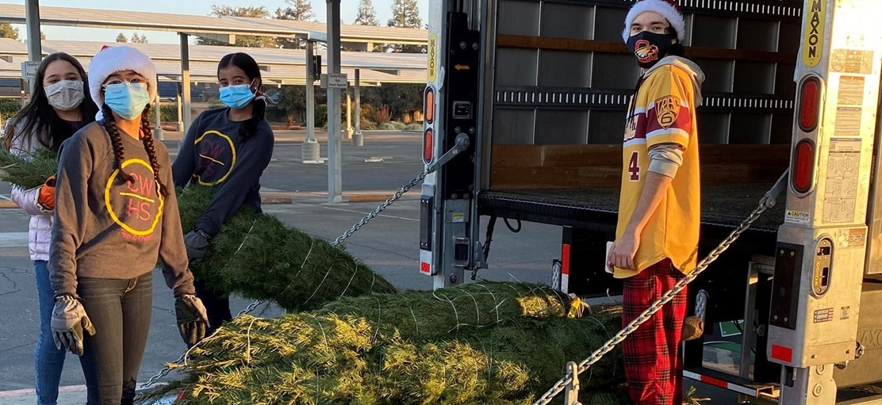
Tips for Electives Tracey Fowlkes
Choose carefully.
Choose an alternative elective.
Electives that require applications:
Peer Counseling
Leadership
Yearbook
Collab Mentoring
Elective Applications are available on the CW registration website.

Slide 12
Graduation Recognitions
Principals Medallion - 3.85 cumulative UNWEIGHTED GPA
Students of Academic Distinction - 4.15 cumulative WEIGHTED GPA and 5+ AP Class
Valedictorian - 4.00 UNWEIGHTED GPA (All As)
Salutatorian - (All As and one (1) B)
Semester Awards
Principal’s Honor Roll - 4.00+
Honor Roll - 3.00-3.99

Slide 13
Advancement via Individual Determination (AVID) Tracey Fowlkes
GPA between 2.0 – 3.5.
Goal to attend a 4-year university.
Strong attendance and citizenship.
Career and College speakers weekly.
High 4-year university acceptance rate.
Reach out to Mrs. Fowlkes for more questions.

Slide 14
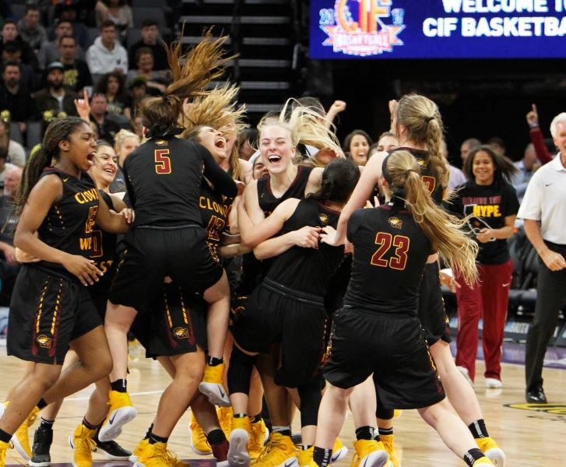
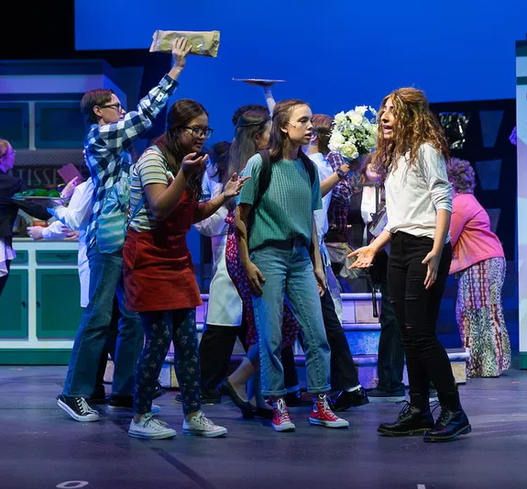
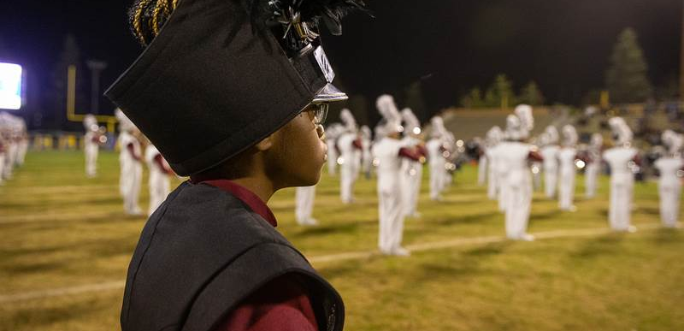
School Involvement Ethan Moreno
Athletics
Academic Teams (Mock Trial, Math Team, Academic Decathlon)
Visual/Performing Arts (S.Hahn/B.Chesi)
CW Drama Programs
Clubs
Community Service

Slide 15
Careers
Ethan Moreno
Clovis West offers several career exploration opportunities for students.
Automotive Pathway
Careers in Education Pathway
Theater Production/Performing Arts
Business and Financial Services
Counselors will discuss opportunities further during Sophomore conferences.

Slide 16
Advanced Placement (AP) Tracey Fowlkes
Clovis West offers 21 AP courses.
Into level college class
AP Exam
College Credit
Demonstrates capability of handling college-level work
Freshman can register for the following:
AP Computer Science Principles - grade of an A or B in Advanced Math 8.
AP Human Geography – students must have a 3.5 GPA and a B or higher in AB History and AB English.

Slide 17
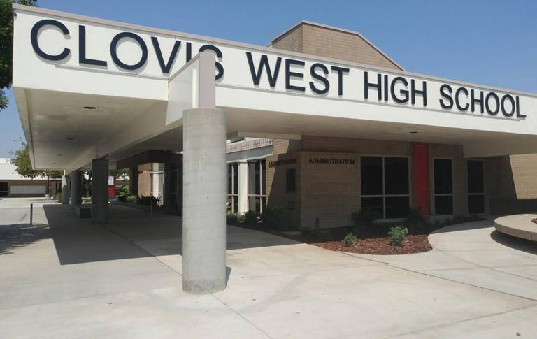
Summer School Ethan Moreno
Location: Clovis West High School – 1070 E Teague Ave, Fresno, CA 93720
Important: Counselors will sign up students for summer school. Students are expected to attend. If you choose not to attend, there is no guarantee the class will be available to you during the school year. Summer school request form will be available on the CW counseling registration website.
Original Credit Classes: (taking for the first time)
3.0 GPA
Impacted Schedule:
Band, Choir
AP Courses
AVID
Leadership, Peer Counseling, Collab Mentoring

Slide 18
Additional Support Tammy Brisky
Tammy Brisky – Head Counselor (559) 327.2120
Tracey Fowlkes – 9th – 12th AVID Counselor (559) 327.2017
Andrea Yang – 9th – 12th Counselor (559) 327.2119
Josie Vargas – 9th – 12th Counselor (559) 327.2121
Ethan Moreno – 9th – 12th Counselor (559) 327.2053
Anthony Bringetto – 9th – 12th Counselor (559) 327.2172
School Psychologists: Brenda Evers, Allison Peck, Silvia Marquez
School Nurse: Hope Garcia
Peer Counselors
CSI (Clovis Support and Intervention
SOAR Team
SRC (Student Responsibility Center)

Slide 19
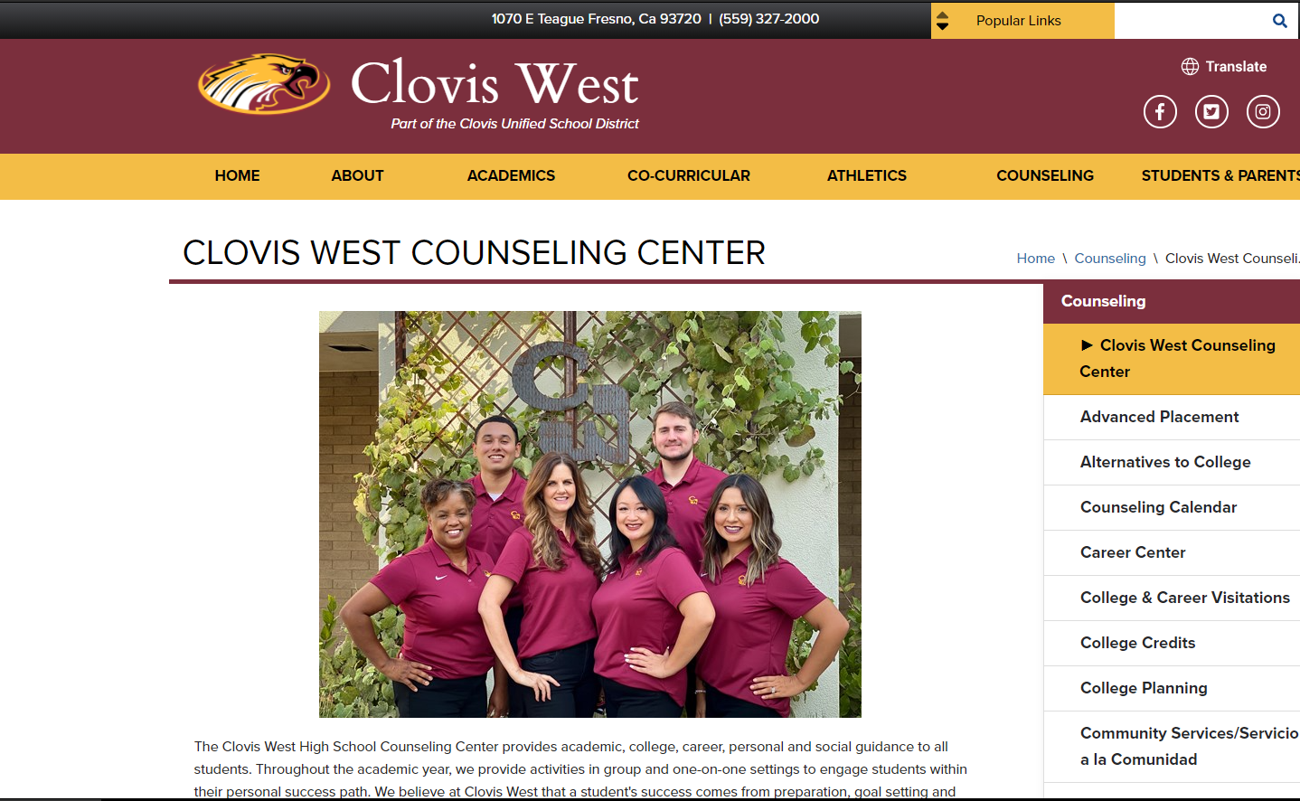
Additional Information Tammy Brisky
CW Counselors will be available during open office hours during incoming 10th grade registration window.
You can access the zoom link in the Class of 2024 Google Classroom.
CW Counseling Website

