Slide 1
Expanded Learning Program
Sierra Vista Elementary 2024-2025

Slide 2
Purpose and Objective
The Expanded Learning Program is created through partnerships between schools and local community resources to provide literacy, academic enrichment, and safe, constructive alternatives for students in grades Trans-Kinder through Sixth. Students will receive homework assistance, enrichment activities, physical activities, and daily snacks to enhance their growth in learning.

Slide 3
Enrollment
Seats are limited to 20 students for grade 1st-6th. Student attendance and behavior may impact their enrollment. All applications will be reviewed and families will be notified about students’ placement be mid June. Please understand that there is a cap for each grade level in which will result in a waiting list.

Slide 4
Attendance
Daily attendance is required for participating students. The program is funded based on students' attendance. Students who have EXCESSIVE unexcused absences will be dropped. Enrolled students must attend the program on days they attend school. If a student is absent from school, they may not attend ELP that day. Students may participate in co-curricular activities then report to ELP.
Excused absences are listed below, but are not limited to:
v Family emergency
v Attending a parallel program (programs in the school or community – Example - clubs, off-site sports, religious training, etc.)
v Medical appointments
v Safety concerns at dusk (Day Light Savings Time Change)
v Transportation considerations

Slide 5
Early Release Policy
To comply with State ASES grant requirements, the program will open immediately after school every day and close at 6:00 pm. Late pick-up will impact your student’s enrollment in the Expanded Learning Program. In order for students to receive the full benefits of this program consistent attendance is necessary. Students who are frequently absent and/or often picked up by parents early may be dropped from the program. Students may be picked up at or after 5:30 pm every day. IF YOUR CHILD MUST BE PICKED UP BEFORE 5:30 P.M., COMPLETE THE FRESH ASP EARLY RELEASE FORM AND RETURN WITH THE REGISTRATION PACKET.

Slide 6
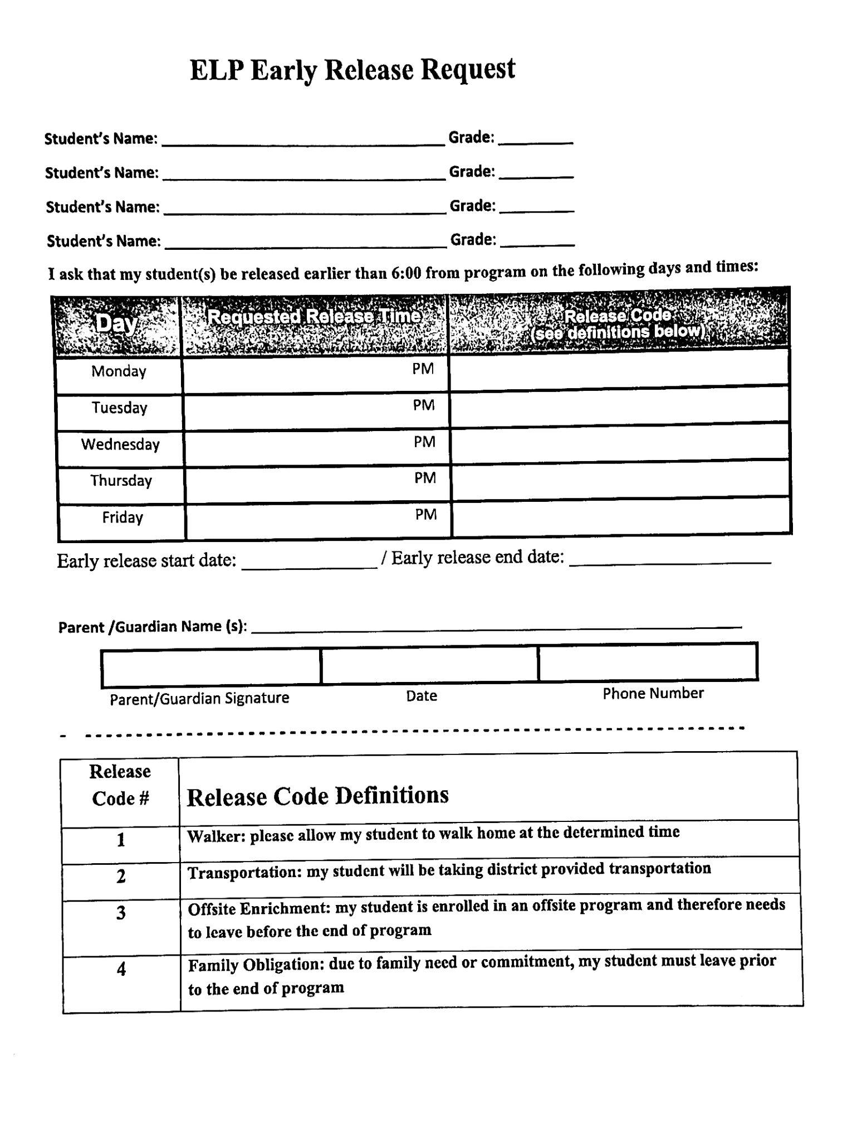
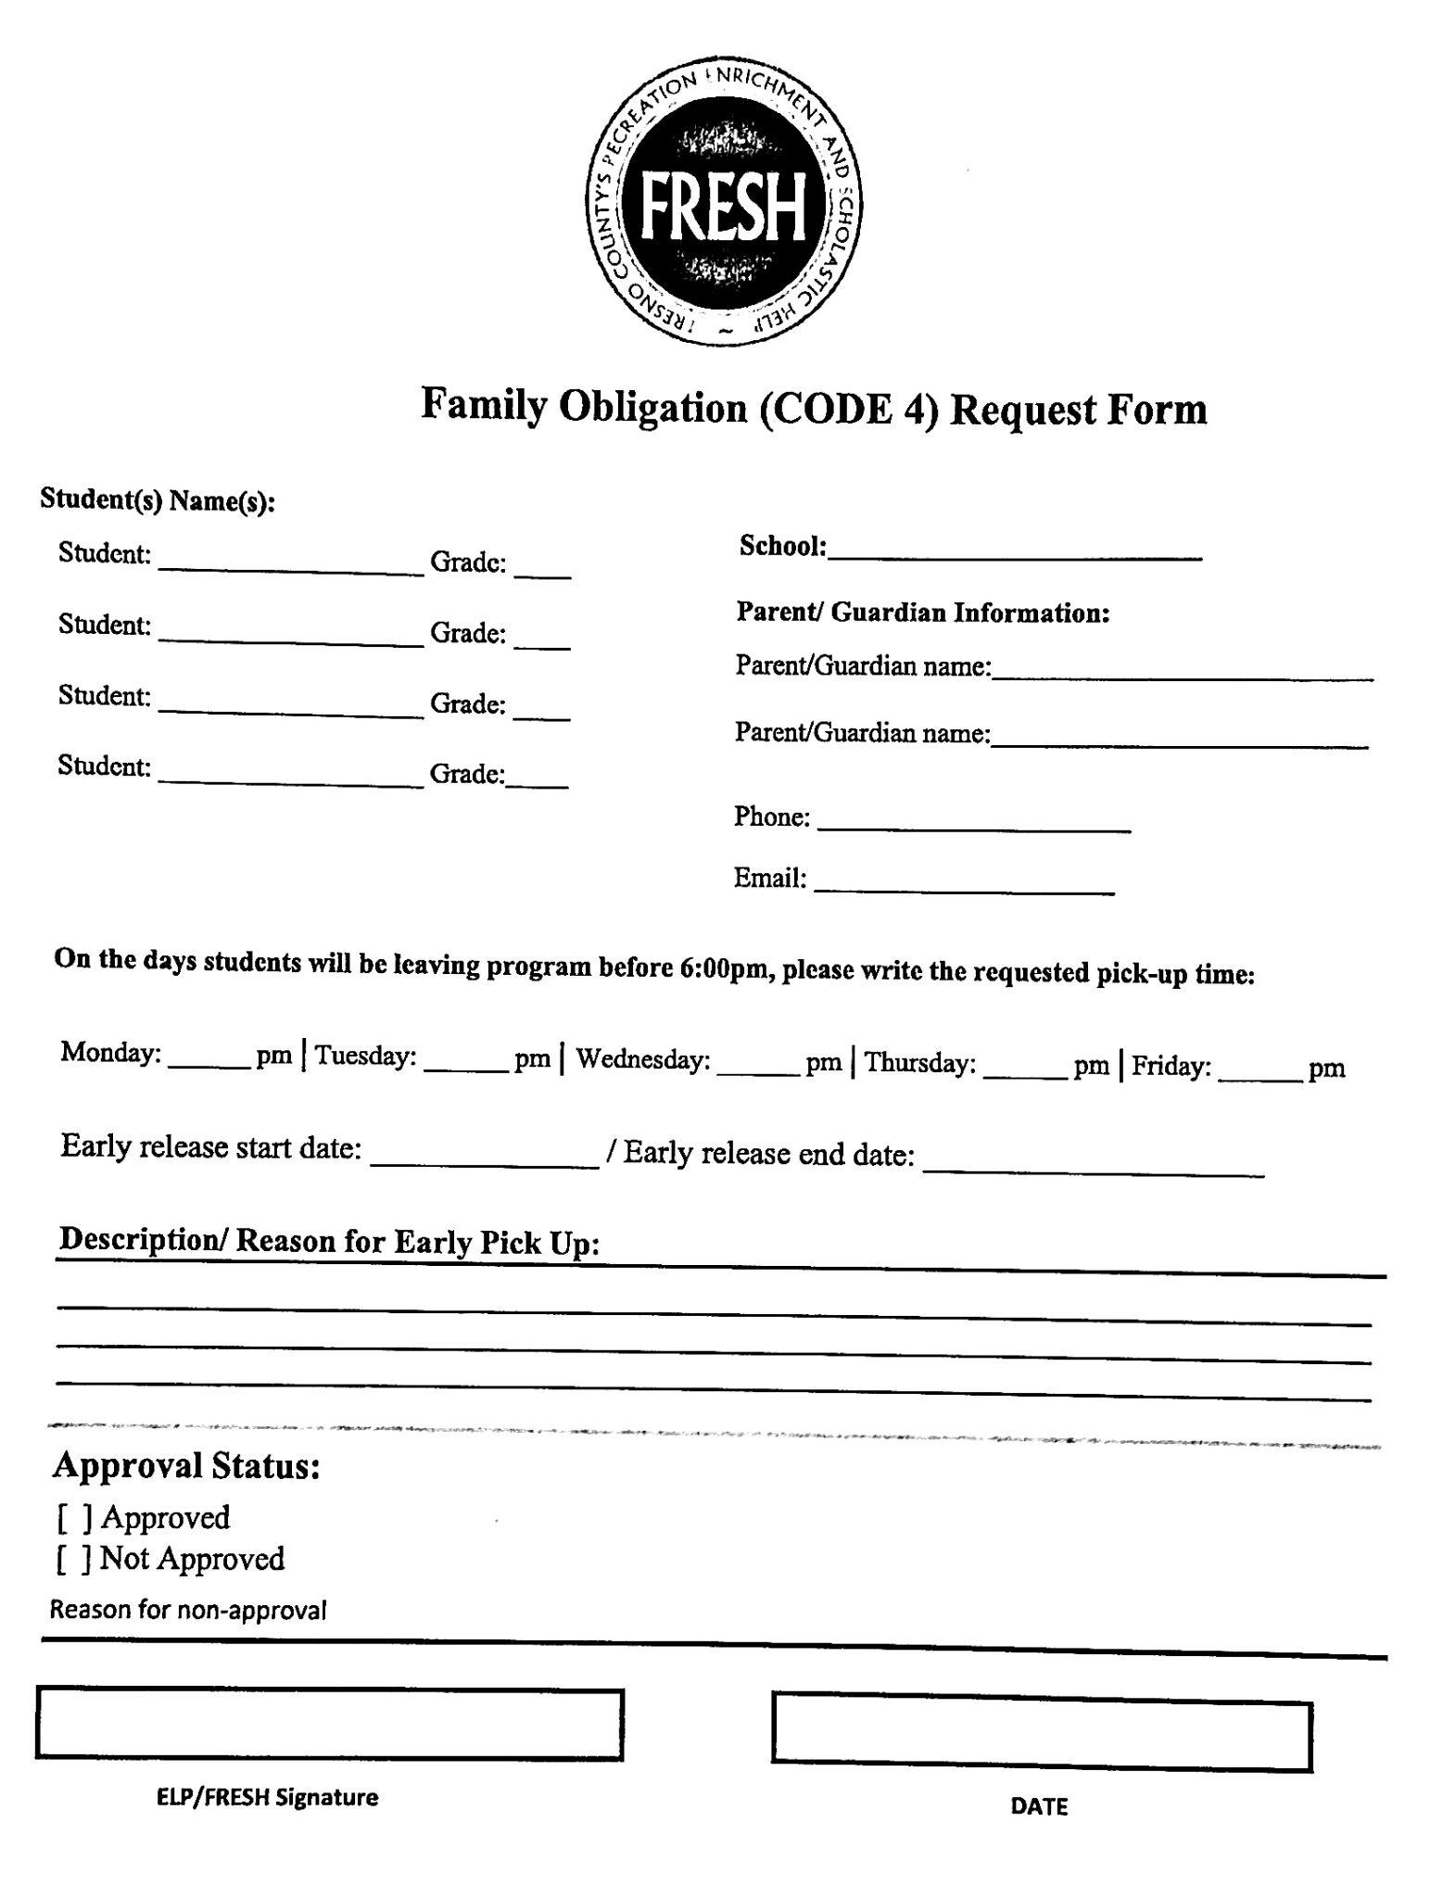
FRESH ASP EARLY RELEASE FORM

Slide 7
California Education Code
Daily attendance is encouraged for students participating in the After School Program. The After School Program requires that programs stay open until 6:00 p.m. and for 15 hours per week. It is, however, understood there may be family commitments, health-related appointments, other outside activities, or safety issues including weather conditions that will occur during the hours of the After School Program. For occasions such as these, you may request an Early Release Form be kept on file for your son/daughter.
California Education Code Section 8483(a) states that:
1. Every after school program shall commence immediately upon the conclusion of the regular school day, and operate a minimum of 15 hours per week, and at least until 6:00 p.m. on every regular school day.
2. It is the intent of the Legislature that elementary school pupils participate in the full day program every day which pupils participates to accomplish program goals

Slide 8
Behavior
Participation in ELP is a privilege. Students are required to be receptive to lessons taught, complete homework, and participate in enrichment activities. Students are expected to follow the Viking student behavior policy as they would during the regular school day. Excessive behavior incidents will affect students' enrollment in the program. Continuous disruptive or disrespectful behavior toward other students or ELP staff is cause for dismissal. We encourage you to discuss concerns about your student’s behavior with the Site Lead.

Slide 9
Liability Policy
ELP is not liable for the payment of expenses incurred as a result of any injuries. Students participating in sports, including Cheer are required to carry medical insurance. ELP is not liable for any personal items that may be damaged or lost.

Slide 10
Program Contact
Sandy Xiong, ELP Site Lead
Email: sandyxiong@clovisusd.k12.ca.us
Phone:(559) 327-7927

